Slide 1
Predicting Customer Bookings of British Airways
Machine Learning Model to Improve Booking Completion Rates

Slide 2
Introduction
Objectives:
Predict whether a customer will complete a booking Or Not.
Dataset:
Contains booking behavior (sales channel, trip type, add-ons….).
Methods Used:
Used Random Forest Classifier Model

Slide 3
Machine Learning Approach
Model Used:
Random Forest
Processing Steps:
Encoded categorical variables like (sales_channel, trip_type)

Slide 4
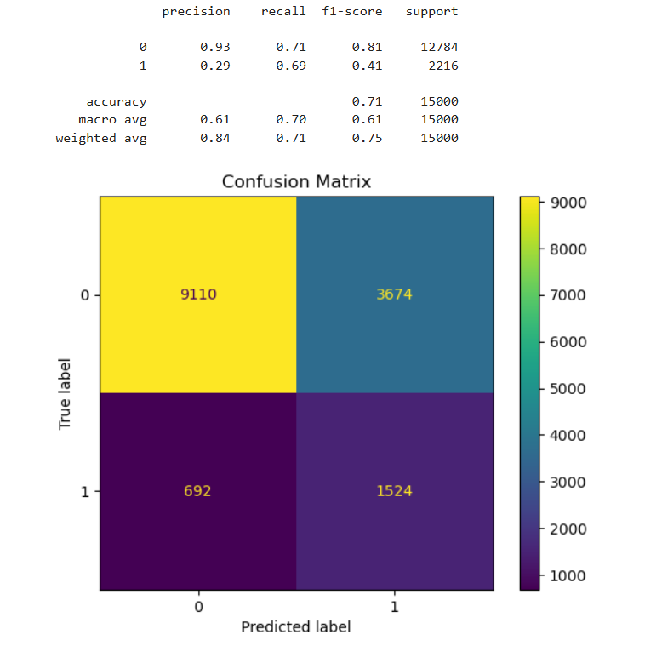
Model Performance
AUC-ROC score
Mean AUC: 0.7637 (±0.0126)
Classification Report ->

Slide 5
Conclusion
Random Forest Classifier Achieves 82% AUC in predicting bookings.

